Slide 1

UNIVERSITY INSTITUTE OF ENGINEERING
DEPARTMENT- ACADEMIC UNITS
Bachelor of Engineering (Computer Science & Engineering)
Subject Name : Elementary Data Structures using C++
Subject Code: 23CSH-103
STACK
DISCOVER . LEARN . EMPOWER

Slide 2


Elementary Data Structure Using C++
Course Objectives
To enable the students to understand various stages and constructs of C++ programming language.
To improve their ability to analyze and address variety of problems in C++.
To understand the concept of data structures and various operations on them.
To understand the properties of various data structures and able to identify the strengths and weaknesses of different data structures.
To analyze and compare the efficiency of algorithms and learn to design efficient algorithms for solving computing problems

Slide 3



Course Outcomes
CO Number | Course Outcome
CO1 | Understand the concepts of object-oriented programming including programming process and compilation process.
CO2 | Apply different techniques to decompose a problem and programmed a solution with various concepts of object-oriented programming language.
CO3 | Analyse and explain the behaviour of linear data structure operations using the programming addressed in the course.
CO4 | Implement and evaluate the programs using the syntax and semantics of object-oriented programming.
CO5 | Design the solution of real-world problems in order to determine that the program performs as expected.

Slide 4

Scheme of Evaluation

Slide 5
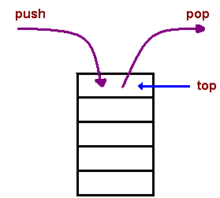
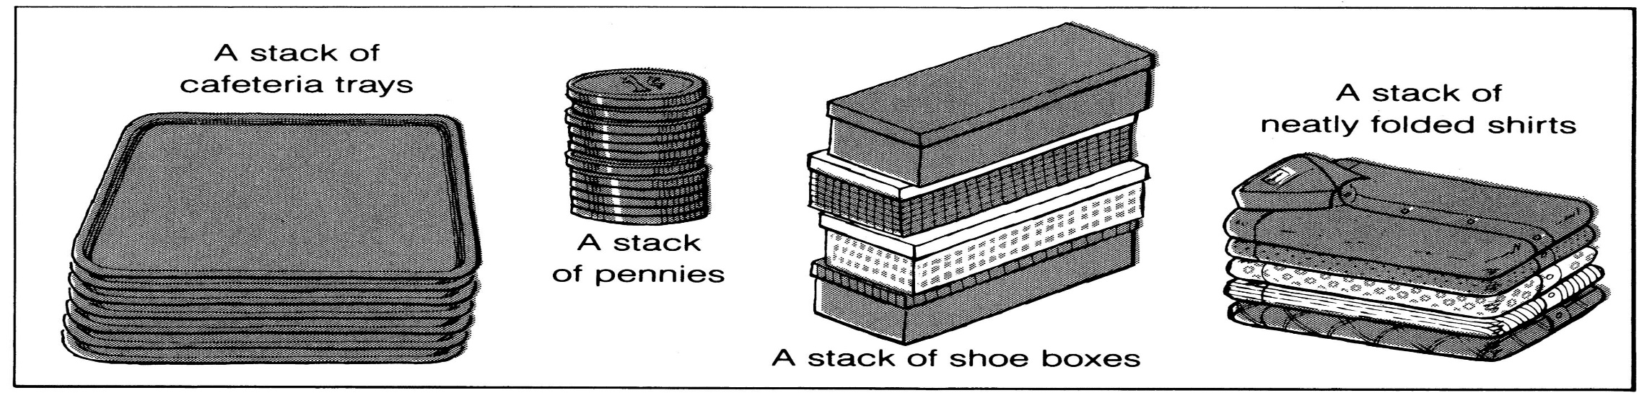
DEFINITION
The last element to be added is the first to be removed (LIFO: Last In, First Out).
A stack is an Abstract Data Type (ADT), commonly used in most programming languages. It is named stack as it behaves like a real-world stack, for example – a deck of cards or stack of trays etc.
It is an ordered group of homogeneous items of elements.
Elements are added to and removed from the top of the stack (the most recently added items are at the top of the stack).

Slide 6
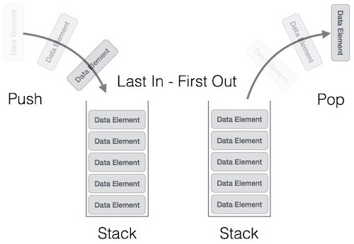
Stack Representation

Slide 7
A stack can be implemented by means of Array, Structure, Pointer, and Linked List. Stack can either be a fixed size one or it may have a sense of dynamic resizing. Here, we are going to implement stack using arrays, which makes it a fixed size stack implementation.
Basic Operations
Stack operations may involve initializing the stack, using it and then de-initializing it. Apart from these basic stuffs, a stack is used for the following two primary operations −
push() − Pushing (storing) an element on the stack.
pop() − Removing (accessing) an element from the stack.
To use a stack efficiently, we need to check the status of stack as well. For the same purpose, the following functionality is added to stacks −
peek() − get the top data element of the stack, without removing it.
isFull() − check if stack is full.
isEmpty() − check if stack is empty.
At all times, we maintain a pointer to the last PUSHed data on the stack. As this pointer always represents the top of the stack, hence named top. The top pointer provides top value of the stack without actually removing it.

Slide 8
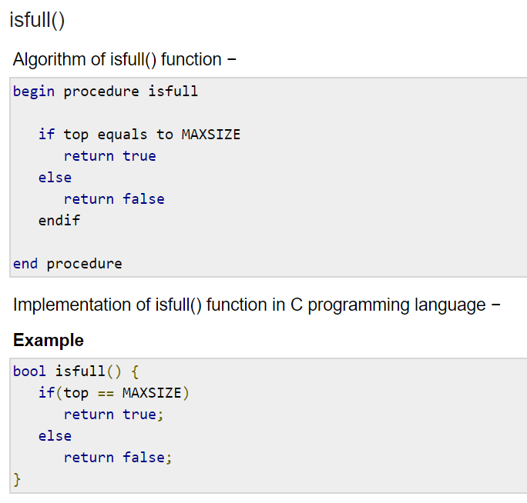
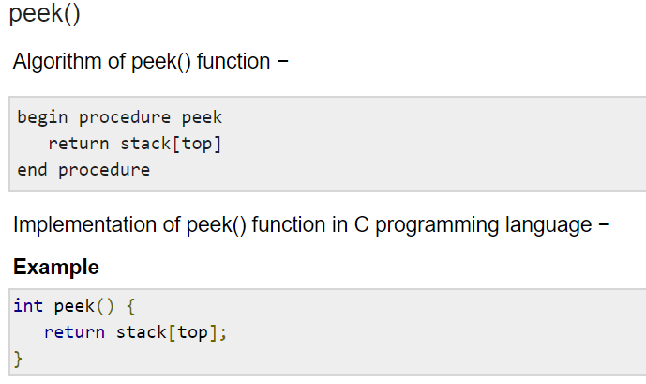

Slide 9
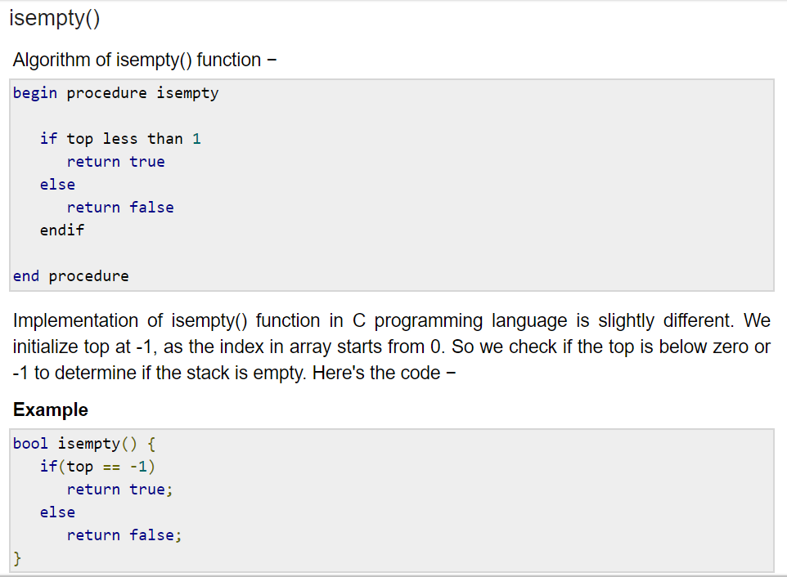

Slide 10
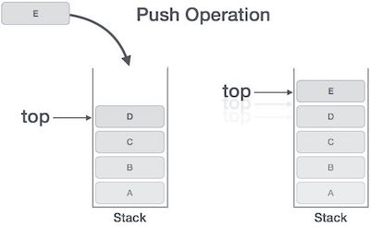
Push Operation
The process of putting a new data element onto stack is known as a Push Operation. Push operation involves a series of steps −
Step 1 − Checks if the stack is full.
Step 2 − If the stack is full, produces an error and exit.
Step 3 − If the stack is not full, increments top to point next empty space.
Step 4 − Adds data element to the stack location, where top is pointing.
Step 5 − Returns success
If the linked list is used to implement the stack, then in step 3, we need to allocate space dynamically

Slide 11
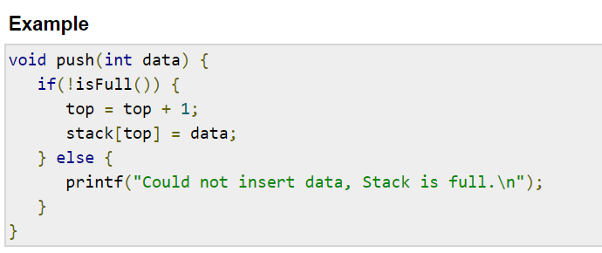
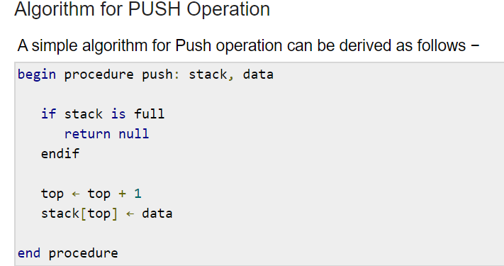

Slide 12
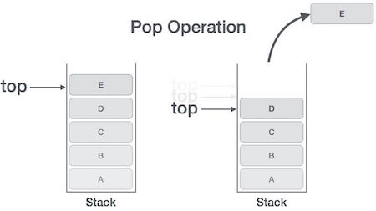
Pop Operation
Accessing the content while removing it from the stack, is known as a Pop Operation. In an array implementation of pop() operation, the data element is not actually removed, instead top is decremented to a lower position in the stack to point to the next value. But in linked-list implementation, pop() actually removes data element and deallocates memory space.
A Pop operation may involve the following steps −
Step 1 − Checks if the stack is empty.
Step 2 − If the stack is empty, produces an error and exit.
Step 3 − If the stack is not empty, accesses the data element at which top is pointing.
Step 4 − Decreases the value of top by 1.
Step 5 − Returns success.

Slide 13
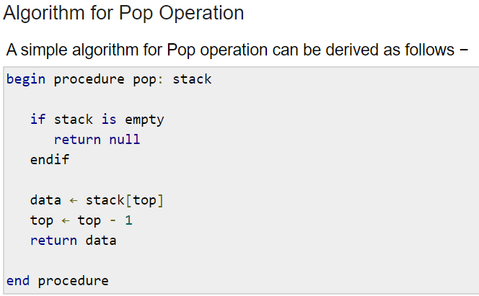

Slide 14
Notations
An arithmetic expression can be written in three different but equivalent notations, i.e., without changing the essence or output of an expression. These notations are −
Infix Notation
Prefix (Polish) Notation
Postfix (Reverse-Polish) Notation
These notations are named as how they use operator in expression. We shall learn the same here in this chapter.
Infix Notation
We write expression in infix notation, e.g. a - b + c, where operators are used in-between operands. It is easy for us humans to read, write, and speak in infix notation but the same does not go well with computing devices. An algorithm to process infix notation could be difficult and costly in terms of time and space consumption.
Prefix Notation
In this notation, operator is prefixed to operands, i.e. operator is written ahead of operands. For example, +ab. This is equivalent to its infix notation a + b. Prefix notation is also known as Polish Notation.

Slide 15
Postfix Notation
This notation style is known as Reversed Polish Notation. In this notation style, the operator is postfixed to the operands i.e., the operator is written after the operands. For example, ab+. This is equivalent to its infix notation a + b.
The following table briefly tries to show the difference in all three notations −
Sr.No. | Infix Notation | Prefix Notation | Postfix Notation
1 | a + b | + a b | a b +
2 | (a + b) ∗ c | ∗ + a b c | a b + c ∗
3 | a ∗ (b + c) | ∗ a + b c | a b c + ∗
4 | a / b + c / d | + / a b / c d | a b / c d / +
5 | (a + b) ∗ (c + d) | ∗ + a b + c d | a b + c d + ∗
6 | ((a + b) ∗ c) - d | - ∗ + a b c d | a b + c ∗ d -

Slide 16
Precedence
When an operand is in between two different operators, which operator will take the operand first, is decided by the precedence of an operator over others.
Associativity
Associativity describes the rule where operators with the same precedence appear in an expression. For example, in expression a + b − c, both + and – have the same precedence, then which part of the expression will be evaluated first, is determined by associativity of those operators. Here, both + and − are left associative, so the expression will be evaluated as (a + b) − c.
Precedence and associativity determines the order of evaluation of an expression. Following is an operator precedence and associativity table (highest to lowest) −
In a + b*c, the expression part b*c will be evaluated first, with multiplication as precedence over addition. We here use parenthesis for a + b to be evaluated first, like (a + b)*c.
Sr.No. | Operator | Precedence | Associativity
1 | Exponentiation ^ | Highest | Right Associative
2 | Multiplication ( ∗ ) & Division ( / ) | Second Highest | Left Associative
3 | Addition ( + ) & Subtraction ( − ) | Lowest | Left Associative

Slide 17
Postfix Evaluation Algorithm
Step 1 − scan the expression from left to right
Step 2 − if it is an operand push it to stack
Step 3 − if it is an operator pull operand from stack and perform operation
Step 4 − store the output of step 3, back to stack
Step 5 − scan the expression until all operands are consumed
Step 6 − pop the stack and perform operation

Slide 18
Applications of Stack
Express Evolution
Express interchange
Infix changes to Postfix
Infix changes to Prefix
Postfix changes to Infix
Prefix changes to Infix
Parsing easily done
Simulation of recursion
Function call

Slide 19
REFERENCES
https://www.cs.cmu.edu/~adamchik/15-121/lectures/Stacks%20and%20Queues/Stacks%20and%20Queues.html
Data Structures with C/ schaum outline series/ volume 2
https://www.geeksforgeeks.org/stack-data-structure-introduction-program/
https://www.geeksforgeeks.org/queue-set-1introduction-and-array-implementation/
http://www.yashcode.com/2017/11/prefix-to-postfix-conversion-using-stack.html
Lipschutz, Seymour, “Data Structures”, Schaum's Outline Series, Tata McGraw Hill.
Gilberg/Forouzan,” Data Structure with C ,Cengage Learning.
Augenstein,Moshe J , Tanenbaum, Aaron M, “Data Structures using C and C++”, Prentice Hall of India.
Goodrich, Michael T., Tamassia, Roberto, and Mount, David M., “Data Structures and Algorithms in C++”, Wiley Student Edition.
Aho, Alfred V., Ullman, Jeffrey D., Hopcroft ,John E. “Data Structures and Algorithms”, Addison Wesley

Slide 20
THANK YOU

